Slide 1
Data Structure and Algorithm
Lecture#13

Slide 2
Divide and conquer
The most well-known algorithm design strategy:
Divide the problem into two or more smaller subproblems.
Conquer the subproblems by solving them recursively.
Combine the solutions to the subproblems into the solutions for the original problem.

Slide 3
Divide and Conquer Algorithm
Merge sort
Quick sort
Binary search

Slide 4

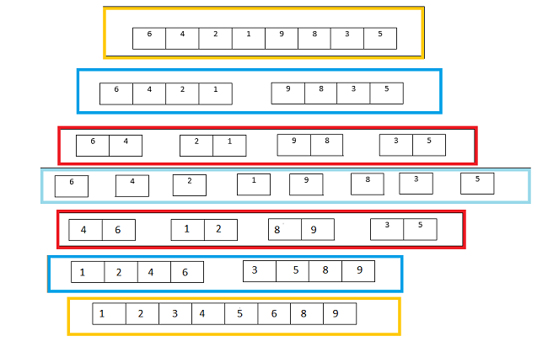
Merge Sort Example#1

Slide 5
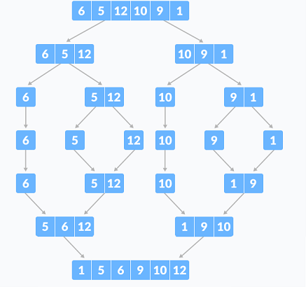
Merge Sort Example#2

Slide 6
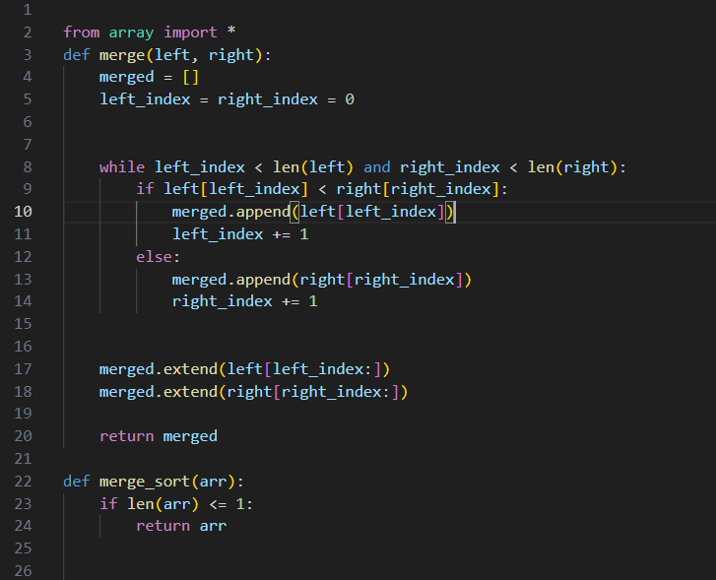
Class Assignment
Explain the code mentioned below by using the detail animation:

Slide 7
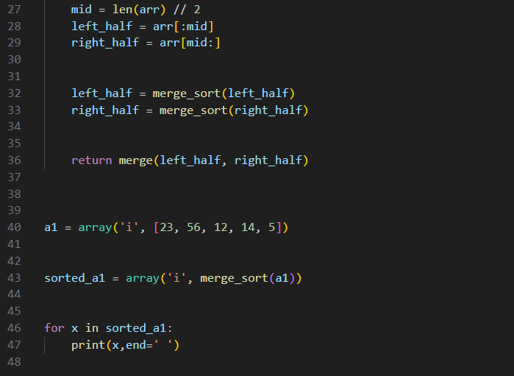
Cont…

Slide 8
THANK
YOU

